Slide 1


Face Recognition
Team Number 8
Ayushi, IGDTUW, B.Tech CSE, Sem 6
Divya Ramesh , MSRIT, B.Tech ECE, Sem 6
Priya Chaturvedi, IGDTUW, MCA, Sem 2
Radhika, IGDTUW, MCA, Sem 2
Surabhi Singh, IGDTUW, MCA, Sem 2
Mentors:
Rishabh Kaushal
Saurabh Gupta

Slide 2
What is ‘face recognition’?
Face recognition is the process of identifying or verifying the identity of a person using their face. It captures, analyzes, and compares patterns based on the person’s facial details. We can break it in three sub-processes: face detection, face capture, face match.
What is the need of facial recognition?
For detection and prevention of crime. Facial recognition CCTV systems can improve performance in carrying public security missions such as:
Find missing children and disoriented adults
Identify and find exploited children
Identify and track criminals
Support and accelerate investigations

Slide 3
Facial Detection vs Facial Identification vs Facial Verification
Detection answers the question: "Is there a human face or not?"
Identification answers the question: “Is that a known/authorized face?”
Verification/Authentication answers the question: "Are you really who you say you are?"

Slide 4
But there are other signatures via the human body as well, such as fingerprints, iris scans, voice recognition, digitization of veins in the palm, and behavioural measurements.
Why facial recognition, then?
Easy to deploy and implement
No physical interaction required

Slide 5
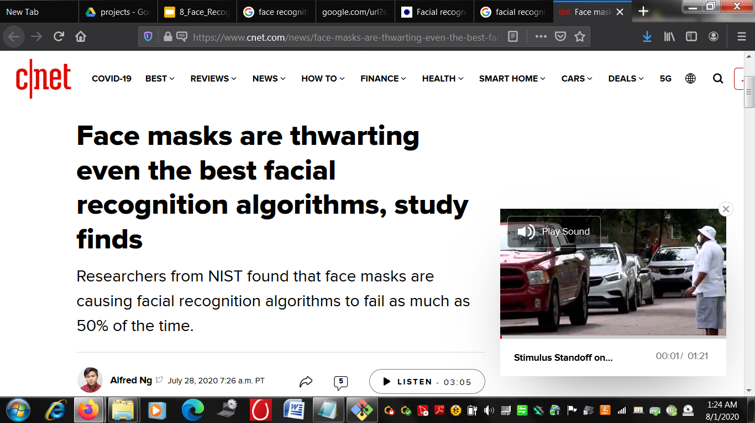
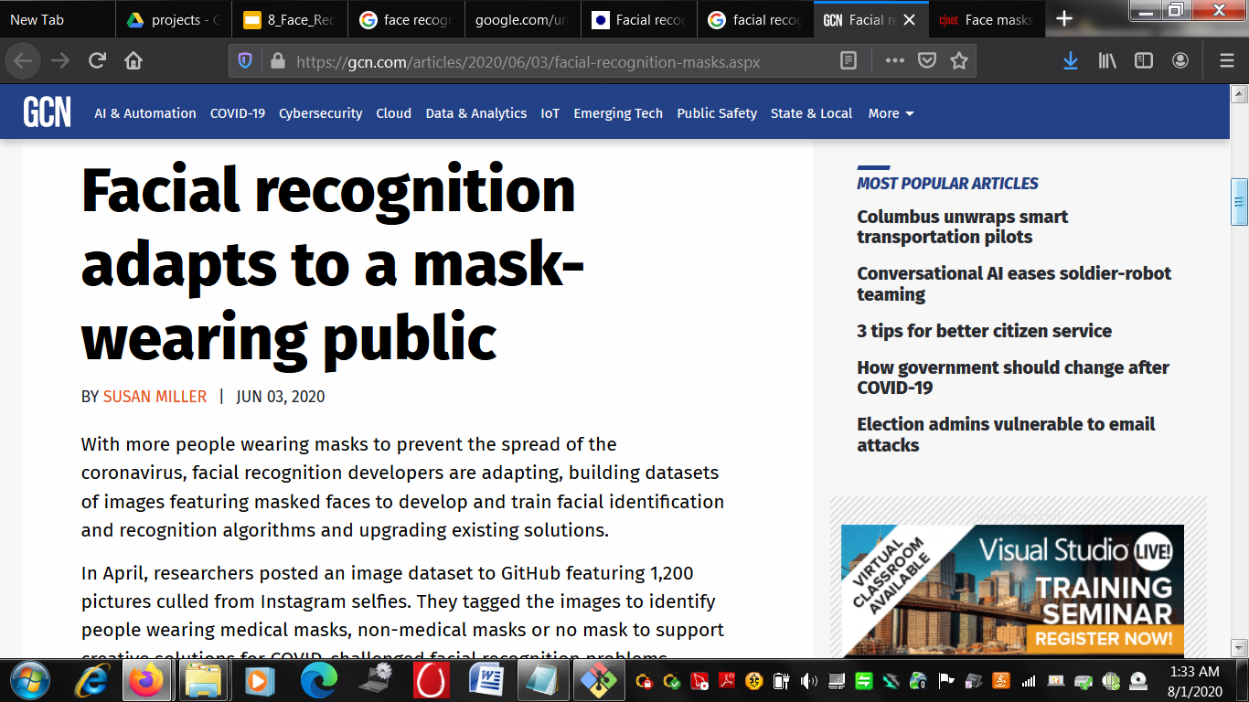
What about facial recognition with masks amidst COVID crisis?

Slide 6
What is our goal?
To develop a method for face verification which when given two input images, one masked and one unmasked, is able to detect if the two images belong to the same person or not.
Our problem of verifying faces can be thought of as a classification problem.
Given a face image space E, we are trying to determine a function:
f: E x E-> {0, 1} that associates the pair (x1, x2) to 0 if it is a genuine pair, and to 1 if it is an imposter pair.

Slide 7
Data Collection
Basis of data collection: There should be ample masked as well as unmasked images of each subject.
Base Dataset: Olivetti dataset collected by researchers at AT&T laboratories. Source: Kaggle
Data Description: 10 different images of each of 40 distinct subjects.
For some subjects, the images were taken at different times, varying the lighting, facial expressions, and facial details.
The images are in PGM format with size for each image as 92x112 pixels, with 256 grey levels per pixel.
Challenges with the dataset: No masked images.

Slide 8
Data Collection: How we modified the dataset to get masked images?
We randomly picked up 4 images from each folder, manually occluded the region of face where mask is worn.
After the modification, our newly formed dataset has following format.
40 folders representing 40 individuals with their names in the form SX, where X indicates the subject number between 1 and 40.
Each folder contains 14 images, out of which first ten are unmasked images with their names as SX_U_N, where X indicates the subject number between 1 and 40, U indicates that the subject is unmasked in this image, and N indicates that this is Nth example image in folder. The remaining 4 images have their names in the form SX_M_N, where M indicates that subject is masked in this image.

Slide 9
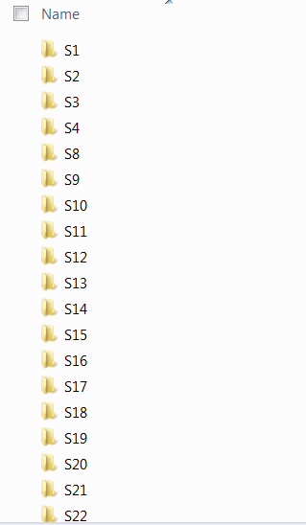
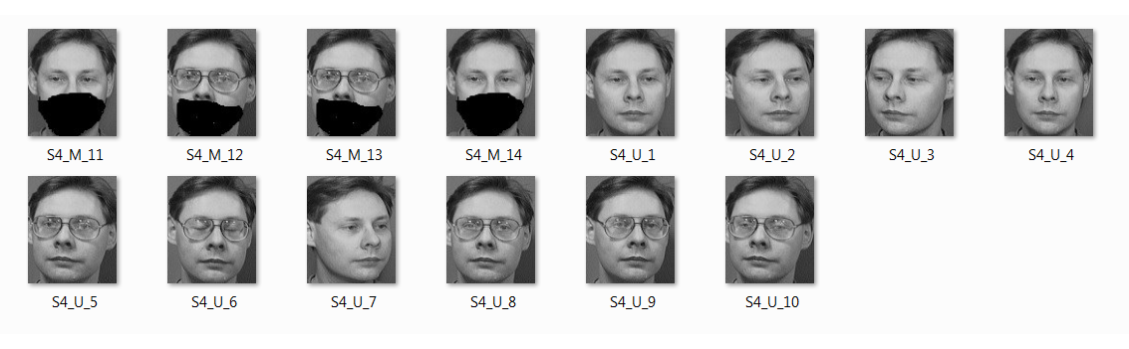
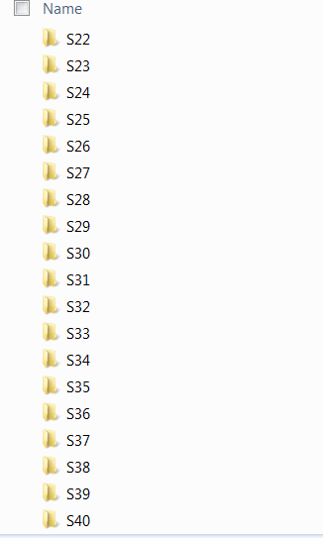
Data Overview

Slide 10
Train-Test Splitting
Two folders: Training and Testing
#folders in Training: 37
#images in each subfolder of training: 14 (10 unmasked and 4 masked)
#folders in Testing: 3
#images in each subfolder of testing: 14 (10 unmasked and 4 masked)
Total dataset size: (40 * 14) = 560

Slide 11
Labeling of Data and Ground Truth
As per our problem statement, we needed our training data in pairs.
So we made tuples, where each tuple contains a pair of two images - one masked and another unmasked, and a label y, where label y will be 0 if both the images belong to the same class (person here) and 1 otherwise.
While training our classifier we made sure to keep equal pairs of both the labels.

Slide 12
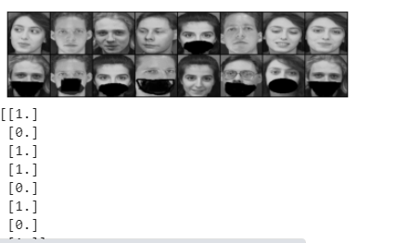
Visualising some of the data
The top row and the bottom row of any column is one pair.
The 0s and 1s correspond to the column of the image.
1 indicates dissimilar/imposter, and 0 indicates similar/genuine.

Slide 13
Our Approach
Since we don’t have huge labelled dataset, we have used one shot learning using Siamese Neural Network. We have implemented this with the help of Pytorch.
In one shot learning we must correctly make predictions given only a single example of each new class.
For doing this, we explored a method for learning Siamese Neural Network which employs a unique structure to naturally rank similarity between inputs.
To calculate the dissimilarity between two input images, we have proposed to use Contrastive loss which calculates the difference using Euclidean Distance.

Slide 14
Project Flow
Load input images
Preprocessing
Labeling of pairs
Making one shot on test input pair
Backpropagating the loss and updating weights and biases
Feature extraction and Training Siamese network on these labeled pairs

Slide 15
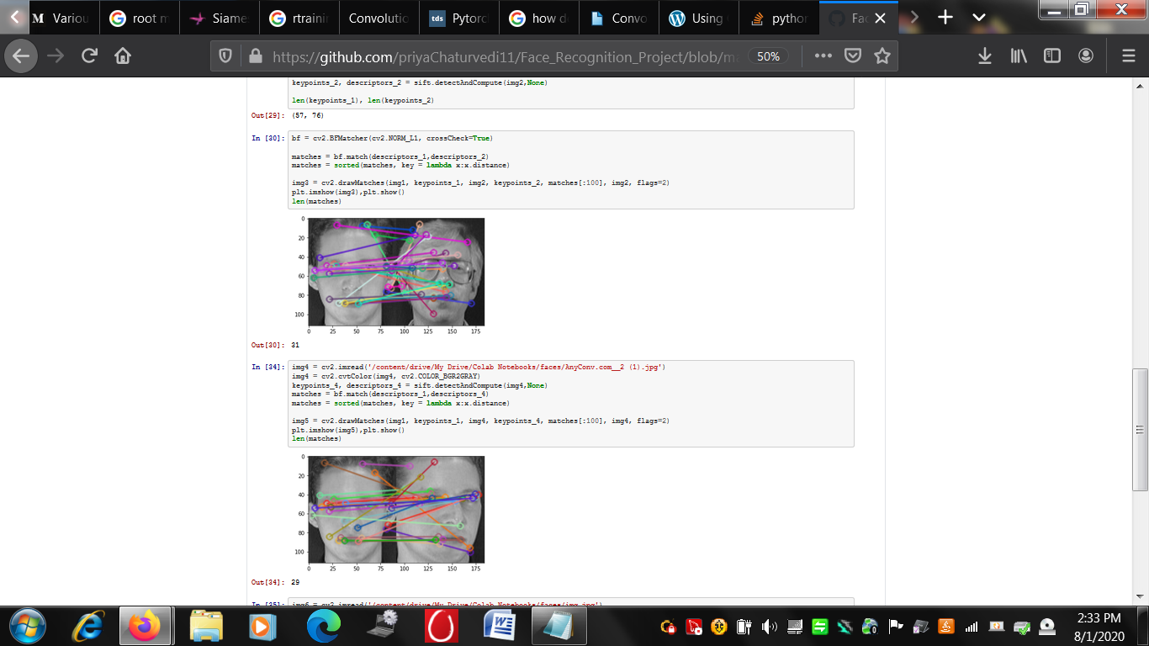
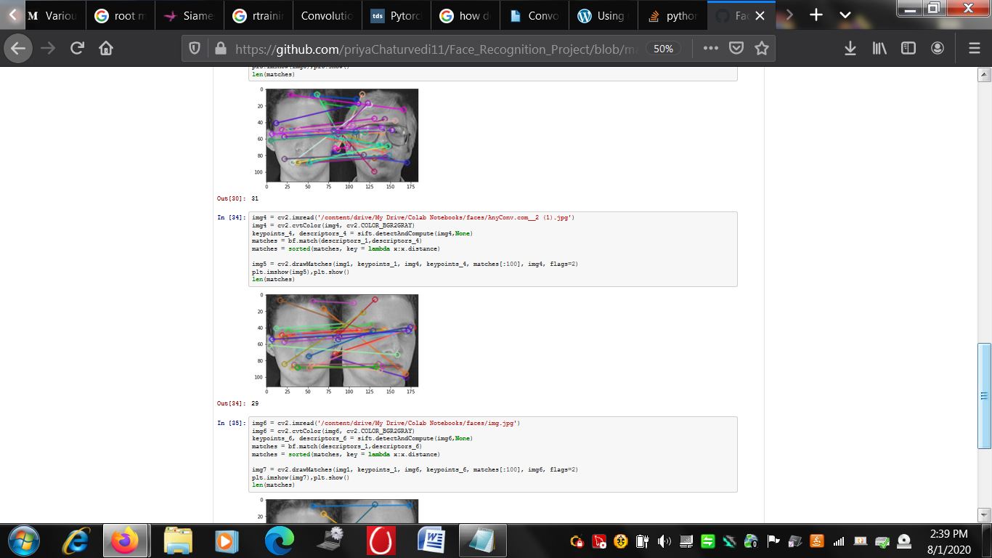
Checking Similarity by Key Point Matching Using OpenCV
Should be used for feature extraction?
Key points Matched: 31
Key points Matched: 29

Slide 16
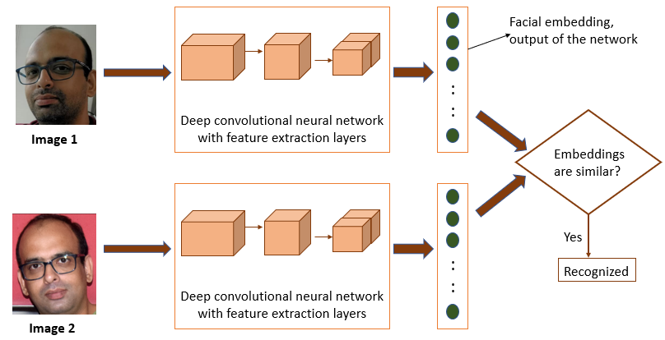
The Architecture

Slide 17
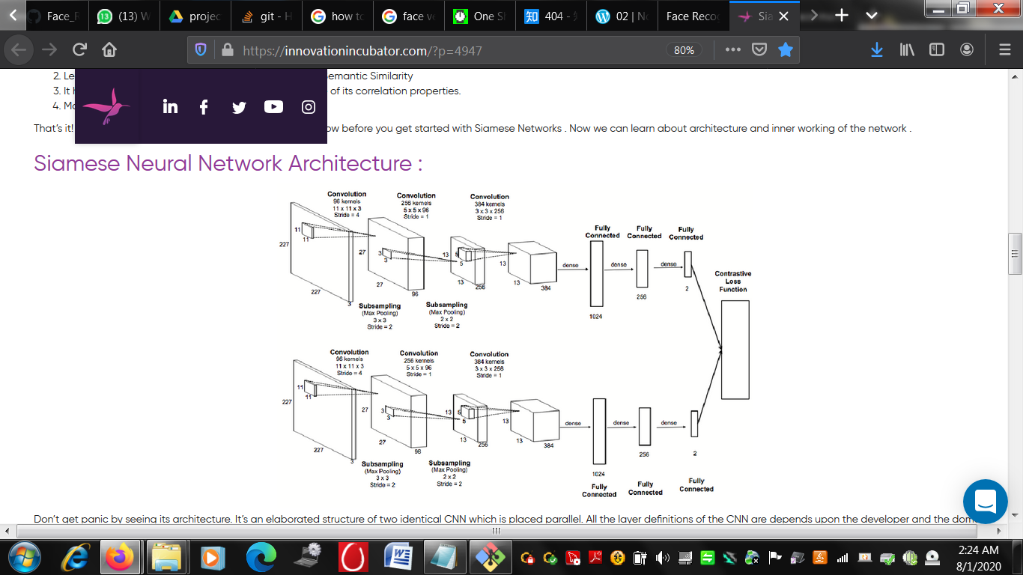
Siamese Neural Network Architecture

Slide 18
Siamese Neural Network Architecture
Conv2d
Conv2d
Linear
Conv2d
Linear
Linear
Contrastive Loss
Linear
Linear
Conv2d
Conv2d
Conv2d
Linear

Slide 19
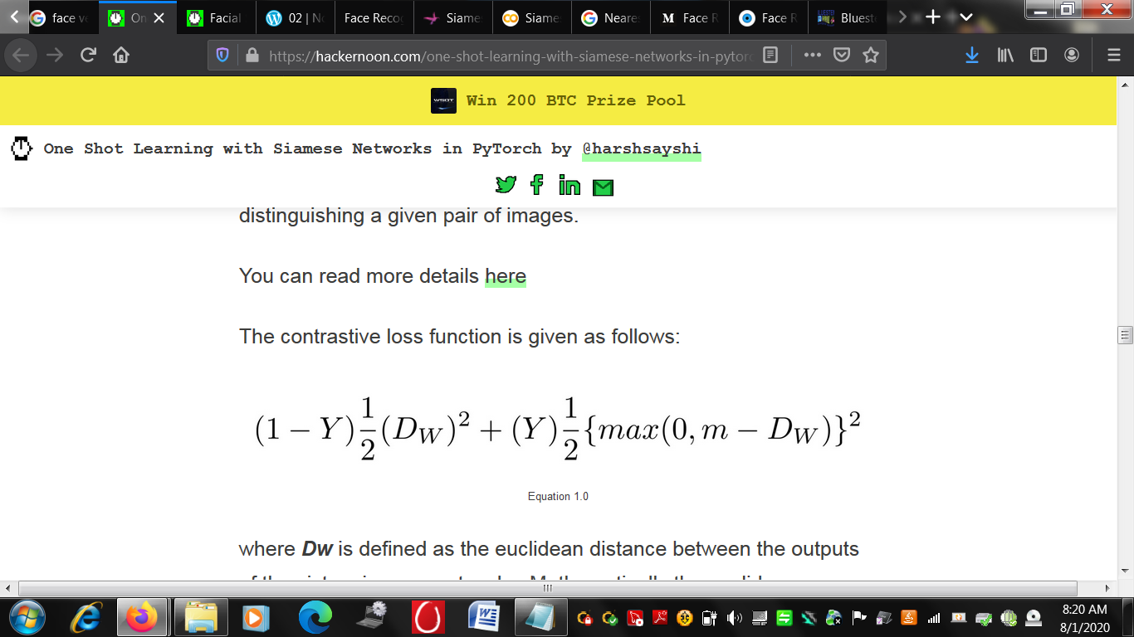
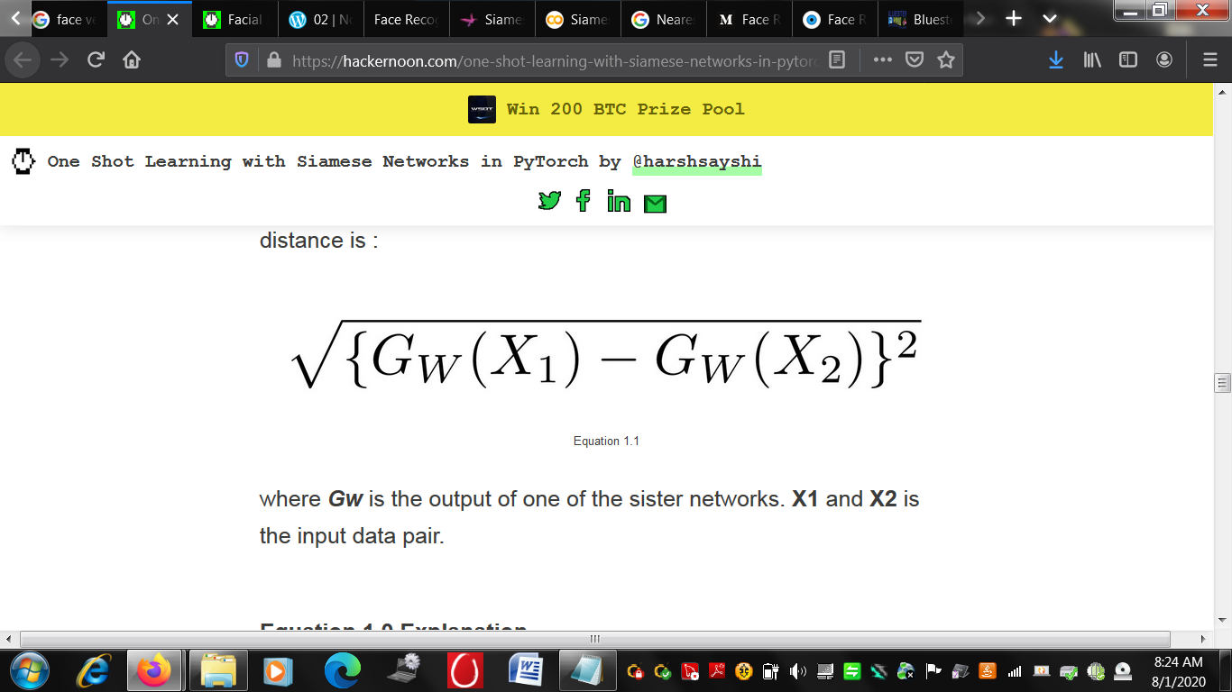
What is Contrastive Loss?
It is defined as follows:
Where Dw is the Euclidean distance between the outputs of the sister siamese networks
Euclidean distance:
Where Gw is the output of one of the sister networks. X1 and X2 is the input data pair.

Slide 20
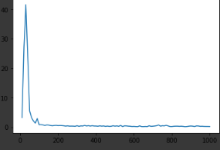
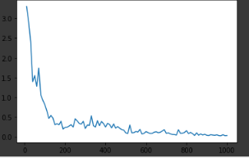
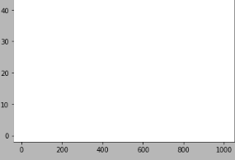
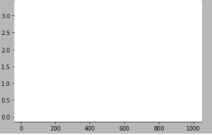
Plots
Loss
Contrastive Loss with Adam Optimizer
Contrastive Loss with RMSProp

Slide 21

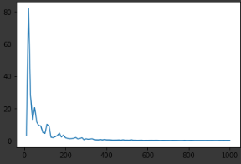

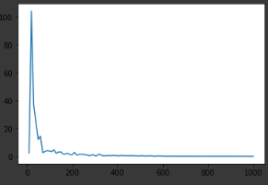
Plots
Counter vs Contrastive Loss :
Epochs: 100 Epochs: 120 Epochs: 100 Epochs:100
Margin: 2.8 Margin: 2.6 Margin: 2.4 Margin:2.2

Slide 22
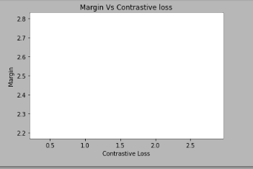
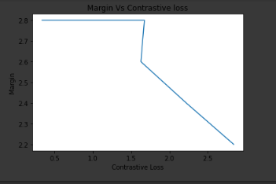
Contrastive Loss vs Margin
Margin vs Contrastive Loss
Testing | Margin | Accuracy
t1 | 2.8 | 75%
t2 | 2.6 | 95%
t3 | 2.4 | 100%
t4 | 2.2 | 85%
t5 | 2.0 | 100%

Slide 23
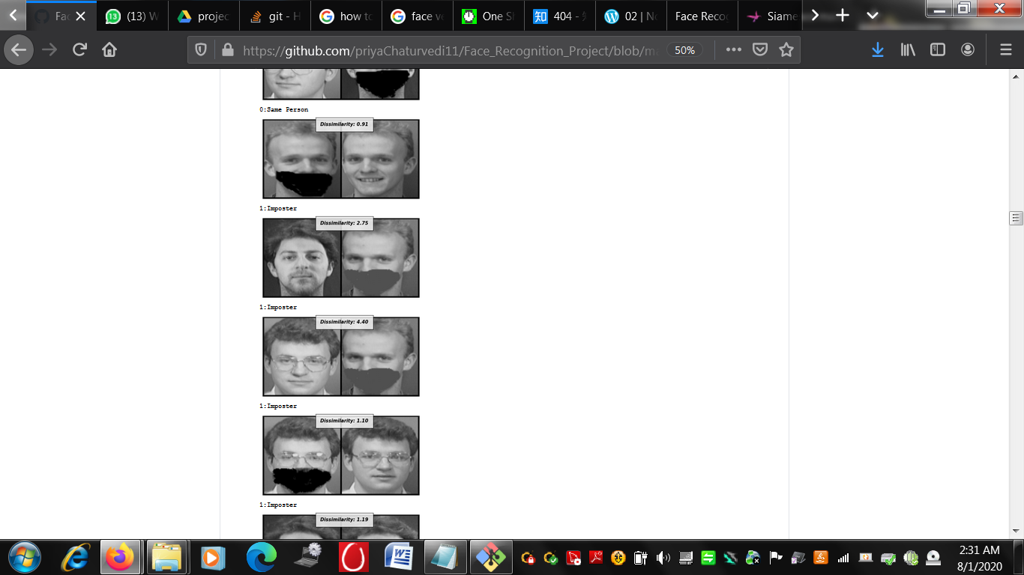
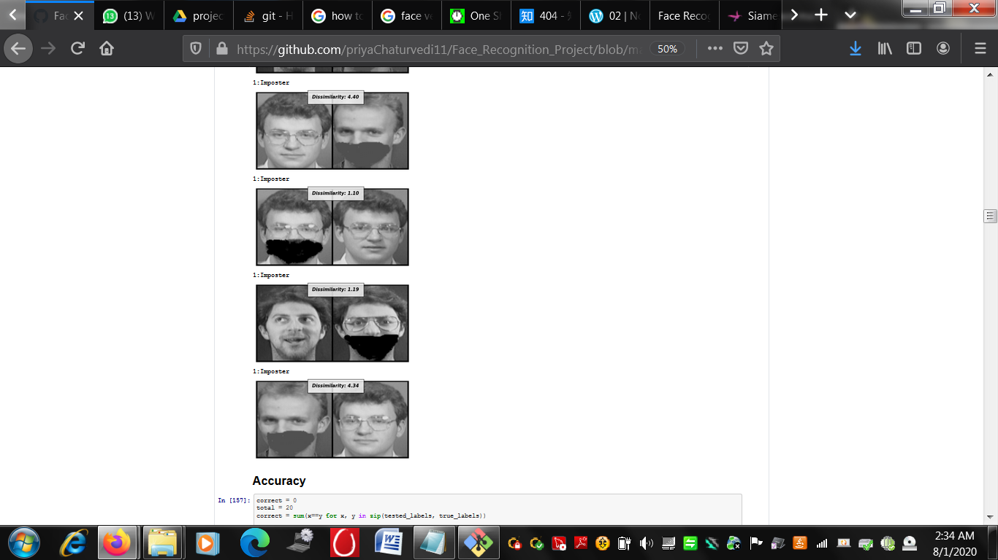
Results for one way one shot learning
Average testing accuracy: 91%
Overfitting? Maybe.

Slide 24
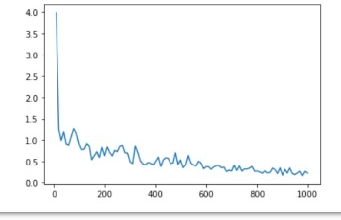
After using Dropout, Probability = 0.5%
Contrastive Loss vs Counter
Average Testing Accuracy: 89%
Max: 100%
Min: 75%
Still overfitting.

Slide 25
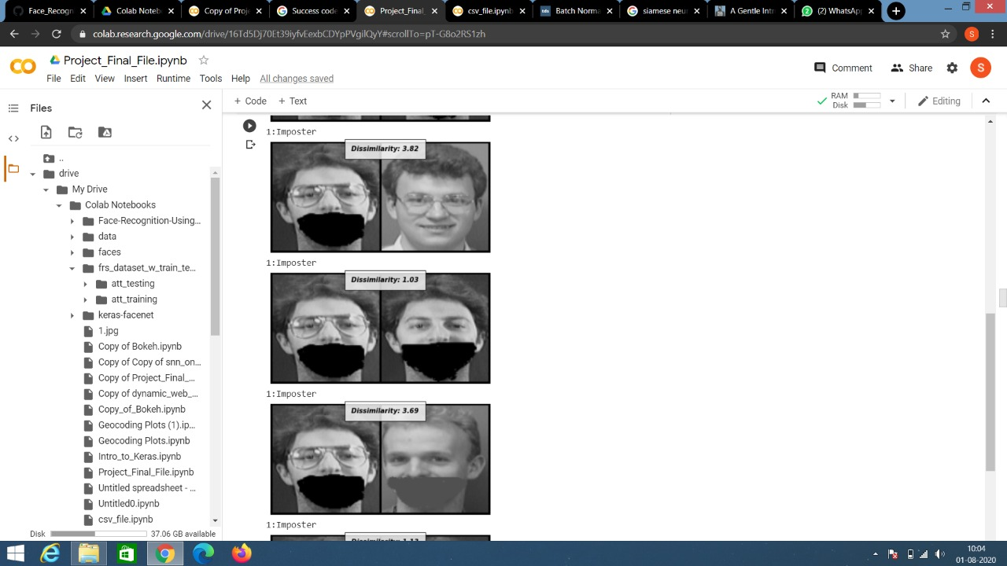
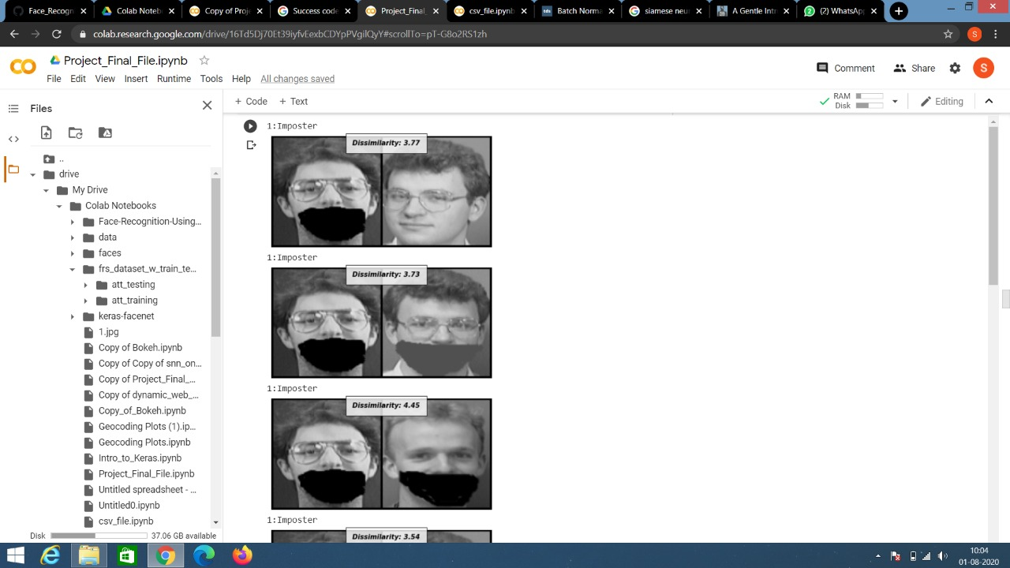
Results for N (=20) way one shot learning
Average testing accuracy: 0.75%

Slide 26
Future Work
We further want to explore one shot learning for facial recognition using FaceNet and Triplet Loss, but that would require relabelling of data to get triplets. And probably deepRanking.
Also, we can use PCA to extract those principal components along which there is maximum variation and then feed transformed image arrays to our siamese neural net in order to improve its performance.
Face verification with Tom-vs-Pete classifiers is another thing that can be explored.
Face Recognition using Wavelet and Neural Networks is also an area to be explored using different tech stacks like Matlab.

Slide 27
References
https://www.cs.cmu.edu/~rsalakhu/papers/oneshot1.pdf
https://sorenbouma.github.io/blog/oneshot/
https://hackernoon.com/facial-similarity-with-siamese-networks-in-pytorch-9642aa9db2f7
https://towardsdatascience.com/one-shot-learning-with-siamese-networks-using-keras-17f34e75bb3d
https://github.com/Rhabia-Fodra/-Face-Recognition-Project-Matlab-Code

